Slide 1
Daily Review
Depth Illusions
The apparent change in depth of an object can be explained using refraction.
Water is more dense than air, so has a higher refractive index.
When the light moves from water into air, it is bent away from the normal.
When the refracted light reaches your eyes, your brain traces the light rays back in a straight line.
This makes the object appear closer to the surface.
Draw a simple diagram to show why your feet and legs appear shorter when you stand in a swimming pool.

Slide 2
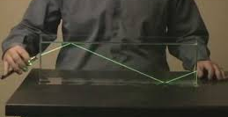
Daily Review
Total Internal Reflection
When light travels from water or glass into air, some light is reflected and some is refracted.
When the angle of incidence is increases, it reaches a critical angle where the light is refracted along the surface.
Any angle of incidence bigger than this will cause the light be reflected inside the object.
Draw a simple diagram to show how light is refracted along the surface at the critical angle.

Slide 3
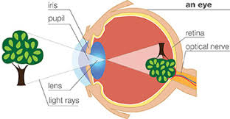
Daily Review
Describing Images Formed With Lenses
Identify the type of lens used. Describe what the lens does to light rays passing through it: converges or diverges
The lens in the eye is a convex lens.
The lens is converging the light rays to form an image on the back of the eye.

Slide 4
Colours of Light Year 9 Physics

Slide 5
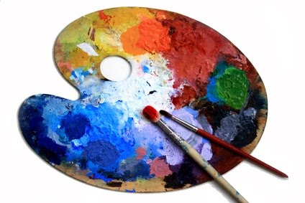
Learning Objectives
CFU
What are we going to learn?
Identify primary and secondary colours of light.
Describe why opaque objects appear to be different colours.
Describe how transparent objects alter the colour of light passing through.
Activate Prior Knowledge
When mixing paint, there are three primary colours: red, yellow and blue.
What happens when you mix two of those colours together?
What are two primary colours mixed together called?

Slide 6
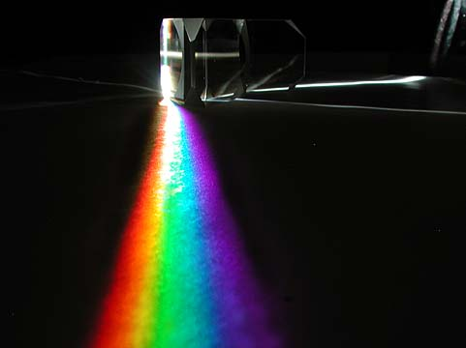
Concept Development
CFU 1
What colour of light is produced by the Sun?
Dispersion of Light
The visible light that comes from the Sun and most light globes is known as white light.
White light can be separated into a range of colours through a process called dispersion.
Each colour of light is refracted by a different amount when moving through materials of different densities.
This produces a separation of colours.
CFU 2
What does dispersion do to white light?
CFU 3
Why do the colours of light separate into different colours?

Slide 7
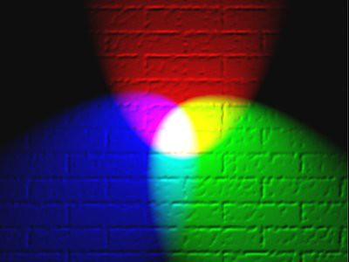
Concept Development
CFU 1
How many basic colours of light are there?
Colours of Light
There are six basic colours of light.
Similar to paint colours, three of these colours are called primary colours.
When two primary colours are mixed, they form secondary colours.
The primary colours of light are red, blue and green.
These are called primary colours because when all three are mixed, they form white light.
CFU 2
How are these colours similar to paint colours?
CFU 3
How are primary light colours different to paint colours?
White
Red
Blue
Green

Slide 8
Concept Development
CFU 1
How are secondary colours of light formed?
Colours of Light
Secondary colours of light are produced when two primary colours are combined.
The secondary colours of light are magenta, cyan and yellow.
Red and blue light mix to form magenta.
Green and red combine to make yellow.
Blue and green put together produce cyan.
CFU 2
Which primary colours mix to form cyan?
CFU 3
What colour is produced from red and green light?
Magenta
Yellow
Cyan

Slide 9
Concept Development
CFU 1
What are complimentary colours?
Complimentary Colours of Light
If cyan and red light are mixed, the result is white light.
This is because the cyan light already contains blue and green, so if red is added the three primary colours are now combined, which makes white light.
When only two colours of light mix to produce white light, they are called complimentary colours.
CFU 2
What colour of light is the compliment of magenta?
CFU 3
What colour of light is the compliment of blue?
Magenta
Red
Yellow
Blue
Green
Cyan

Slide 10
Concept Development
CFU 1
What happens when light falls on opaque objects?
Colours of Opaque Objects
When white light falls on opaque objects, some colours of light are reflected and some are absorbed by the object.
The colour the object appears depends on the mix of colours that reflect into our eyes.
It is easier to consider white light as just made up of red, green and blue light, as other colours can be made from them.
CFU 2
What does the colour of an object depend on?

Slide 11

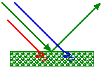

Concept Development
CFU 1
Why do red objects appear red under white light?
Colours of Opaque Objects
Red objects appear red because red light is reflected into our eyes, and the other colours are absorbed.
Green objects appear green because green light is reflected into our eyes and the other colours are absorbed.
Yellow objects appear yellow because green and red light are reflected into our eyes and when they mix, they form yellow.
Black objects absorb all colours of light and reflect no light.
CFU 2
Which colours of light are absorbed by a green object?
CFU 3
If an object appears magenta, what colours of light are reflected?
CFU 4
Why do objects appear black?

Slide 12
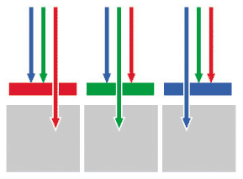
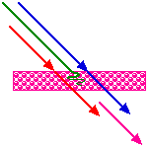
Concept Development
CFU 1
What does a green transparent object do to light passing through it?
Colours of Transparent Objects
Similar to opaque objects, transparent objects absorb some colours of light, but they also let light pass through them.
A green transparent objects will allow green light to pass through and absorb the other colours.
A magenta transparent will allow blue and red light to pass through and when they mix, they form magenta.
CFU 2
Which colours of light are absorbed by a blue transparent object?
CFU 3
If an object appears cyan, what colours of light are passing through?

Slide 13
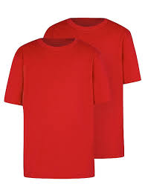
Skill Development/Guided Practice
CFU 1
Is the object opaque or transparent?
Explaining Coloured Objects
State whether the object is opaque or transparent. State the colour the object appears. Describe which colours reflected/pass through the object and which are absorbed by the object.
CFU 2
What colour is the object?
The t-shirt is opaque and appears red.
Red light is reflected. Blue and green light is absorbed.
CFU 3
What colours are reflected/pass through?
Magenta
Red
CFU 4
What colours are absorbed?
Yellow
Blue
Green
Cyan

Slide 14
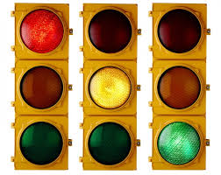
Skill Development/Guided Practice
CFU 1
Is the object opaque or transparent?
Explaining Coloured Objects
State whether the object is opaque or transparent. State the colour the object appears. Describe which colours reflected/pass through the object and which are absorbed by the object.
CFU 2
What colour is the object?
The traffic light is transparent and appears green.
Green light is passing through. Blue and red light is absorbed.
CFU 3
What colours are reflected/pass through?
Magenta
Red
CFU 4
What colours are absorbed?
Yellow
Blue
Green
Cyan

Slide 15
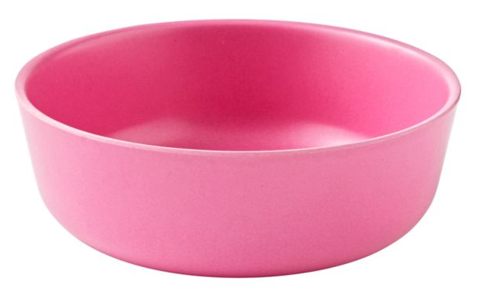
Skill Development/Guided Practice
CFU 1
Is the object opaque or transparent?
Explaining Coloured Objects
State whether the object is opaque or transparent. State the colour the object appears. Describe which colours reflected/pass through the object and which are absorbed by the object.
CFU 2
What colour is the object?
The bowl is opaque and appears magenta.
Red and blue light is reflected. Green light is absorbed.
CFU 3
What colours are reflected/pass through?
Magenta
Red
CFU 4
What colours are absorbed?
Yellow
Blue
Green
Cyan

Slide 16
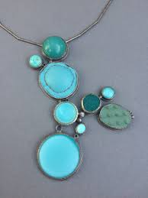
Skill Development/Guided Practice
CFU 1
Is the object opaque or transparent?
Explaining Coloured Objects
State whether the object is opaque or transparent. State the colour the object appears. Describe which colours reflected/pass through the object and which are absorbed by the object.
CFU 2
What colour is the object?
The ______ is _______and appears _______. ________ light is reflected / passing through. ______ light is absorbed.
CFU 3
What colours are reflected/pass through?
Magenta
Red
CFU 4
What colours are absorbed?
Yellow
Blue
Green
Cyan

Slide 17
Skill Development/Guided Practice
CFU 1
Is the object opaque or transparent?
Explaining Coloured Objects
State whether the object is opaque or transparent. State the colour the object appears. Describe which colours reflected/pass through the object and which are absorbed by the object.
CFU 2
What colour is the object?
The ______ is _______and appears _______. ________ light is reflected / passing through. ______ light is absorbed.
CFU 3
What colours are reflected/pass through?
Magenta
Red
CFU 4
What colours are absorbed?
Yellow
Blue
Green
Cyan

Slide 18
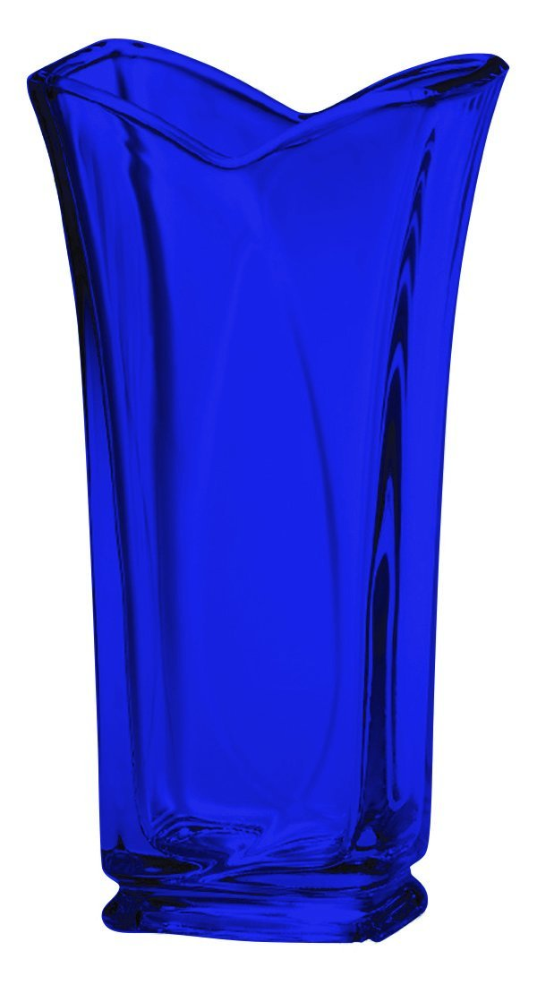
Skill Development/Guided Practice
CFU 1
Is the object opaque or transparent?
Explaining Coloured Objects
State whether the object is opaque or transparent. State the colour the object appears. Describe which colours reflected/pass through the object and which are absorbed by the object.
CFU 2
What colour is the object?
The ______ is _______and appears _______. ________ light is reflected / passing through. ______ light is absorbed.
CFU 3
What colours are reflected/pass through?
Magenta
Red
CFU 4
What colours are absorbed?
Yellow
Blue
Green
Cyan

Slide 19
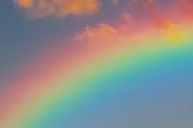
Relevance
White light is dispersed into different colours as it refracts through transparent substances.
The dispersion of light in water droplets in air causes rainbows to form in the sky.
We are able to see different coloured objects because of the colours of light that are reflected off them.

Slide 20
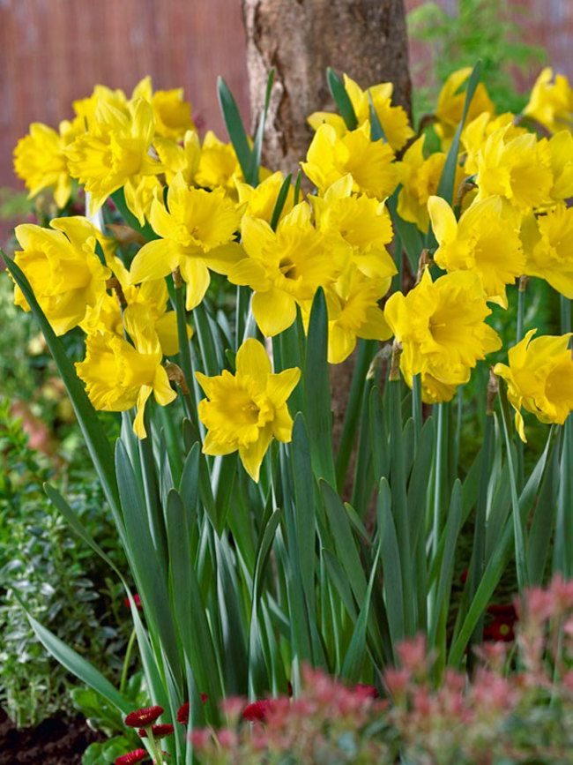
Skill Closure
Explaining Coloured Objects
State whether the object is opaque or transparent. State the colour the object appears. Describe which colours reflected/pass through the object and which are absorbed by the object.
What is dispersion of white light?
Skill Closure
Classify these colours as either primary colours or secondary colours of light.
Red Magenta Green Blue Cyan Yellow
Skill Closure
Magenta
Red
Yellow
Explain why the flowers of a daffodil appear yellow and the leaves appear green.
Blue
Green
Cyan

Slide 21
Independent Practice
Complete the questions below on your device or in your book.
Explain the meaning of the term ‘dispersion’.
What is the difference between a primary colour and a secondary colour of light?
List the three primary colours of light and the three secondary colours of light.
Draw a Venn diagram to show how the primary colours mix to form the secondary colours of light.
What are complimentary colours of light? Give an example.
Complete the table below to show what colours are absorbed and reflected or pass through for each of the objects.
Object | Colours Reflected or Passing Through | Colours Absorbed
Red car
Yellow banana
Magenta glass jar
Black bowling ball
Green traffic light
White paper

Slide 22
Independent Practice
Complete the Colours of Light worksheet on your device or on a paper copy.

